Slide 1

High throughput data analysis
Features filtering

Slide 2
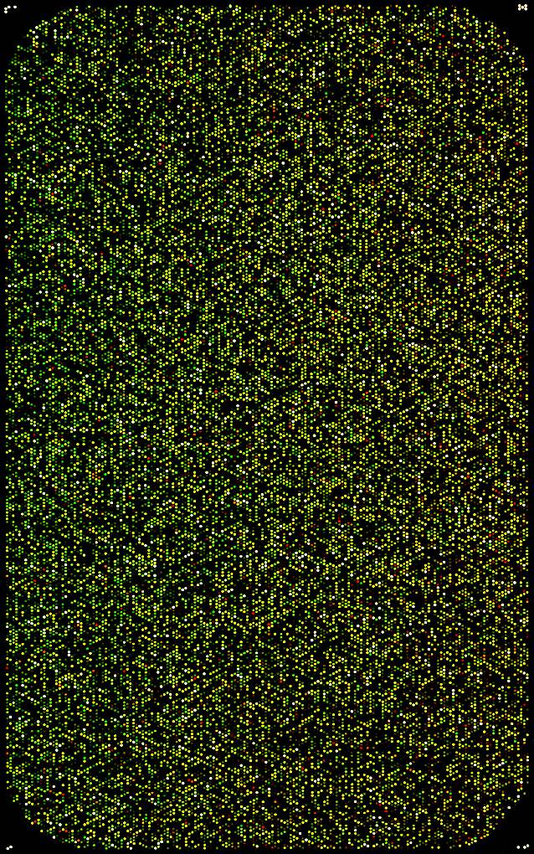
Main idea
Microarrays contain information, but not only.
People generally apply filters before analyzing data.
(1)
(2)
Reduce the variable (probes) space.
Multiple hypothesis testing.
Improve the signatures.
Informative
Non informative

Slide 3
‘State of the art’
Commonly used methods:
Probes for which at least p% of samples have a signal > threshold (but what threshold?)
Mean of signal > threshold (but what threshold?)
Variance of signal > threshold (but what threshold?)
Methods combining mean and variance (Marczyk et al. Bioinformatics 2013)
Bayesian approach (Talloen et al. Bioinformatics 2007, FARMS R package)
Principal Components Analysis (Lu et al. Nucleic acid Research 2011)

Slide 4

Consensus
“[…] In an application to microarray data, we found that gene-by-gene filtering by overall variance followed by a t-test increased the number of discoveries by 50%.” PNAS, 2010.

Slide 5

TCGA papers
4 steps sequential filtering on Gene Exprs. Data (RNA sequencing):
1 - Not well-annotated genes
2 - Less than 25% of samples with intensity > low value (?)
3 - Low SNR where SNR = Z score (?)
4 - Variance < q85 of variances
1368 genes

Slide 6
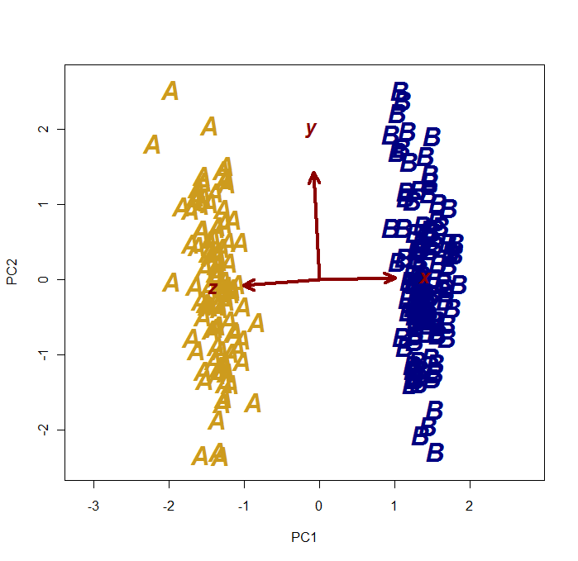
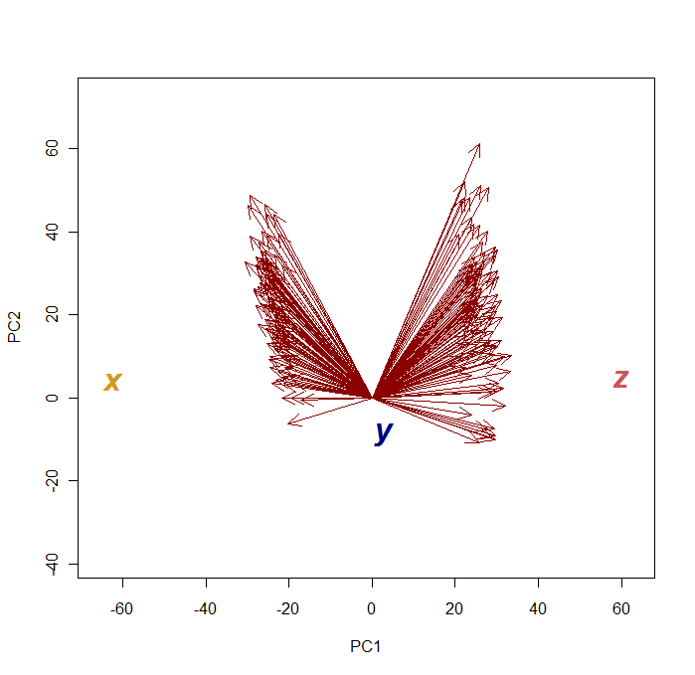
A trivial example
A 2 groups (A, B) example, described by 3 covariates (x, y, z), with
X_{A} ≠ X_{B} Y_{A} ~ Y_{B} Z_{A} ≠ Z_{B}
Observations Vs. variables
Variables Vs. Observations
Y appears close to (0, 0)

Slide 7
Original Idea
PCA on samples
Data
xxxxxxxxxx
xxxxxxxxxx
xxxxxxxxxx
xxxxxxxxxx
….
xxxxxxxxxx
xxxxxxxxxx
PC2
PC1
…PCA on probes.
Non informative region
x
x
x
x
x
x
x
x
x
x
x
x
x
x
x
x
x
x
x
x
x
x
x
x
x
x
x
x
x
x
x
x
x
PCn+1
x
x
x
x
x
x
x
x
x
x
x
x
x
x
x
x
x
x
x
x
x
x
x
x
x
x
x
x
x
x
x
x
x
x
x
x
x
x
x
x
x
x
x
x
x
x
x
x
x
x
x
x
x
x
x
x
x
x
x
x
x
x
PCn

Slide 8
How to define the non-informative region?

Slide 9
Real Gene exprs. data
Lee dataset: lung, N = 138
- adenocarcinomas, n = 62
- squamous carcinomas, n = 76
- GEO: GSE8894, PMID: 19010856
- platform: Affymetrix U133 Plus 2.0

Slide 10
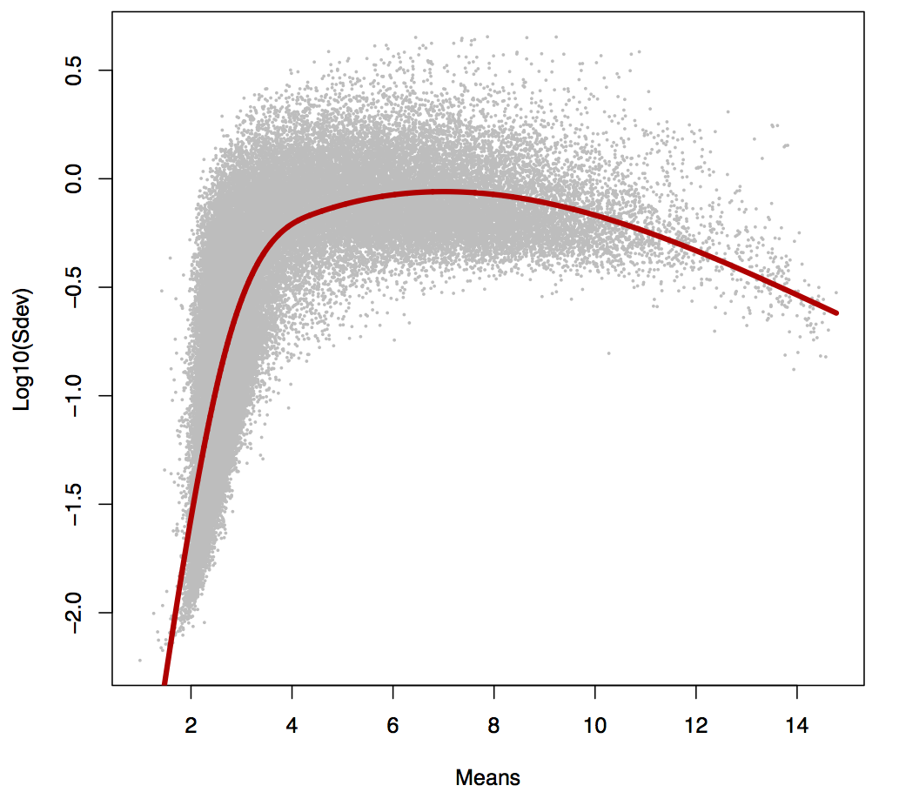
Standard deviations Vs. means (per probe)

Slide 11
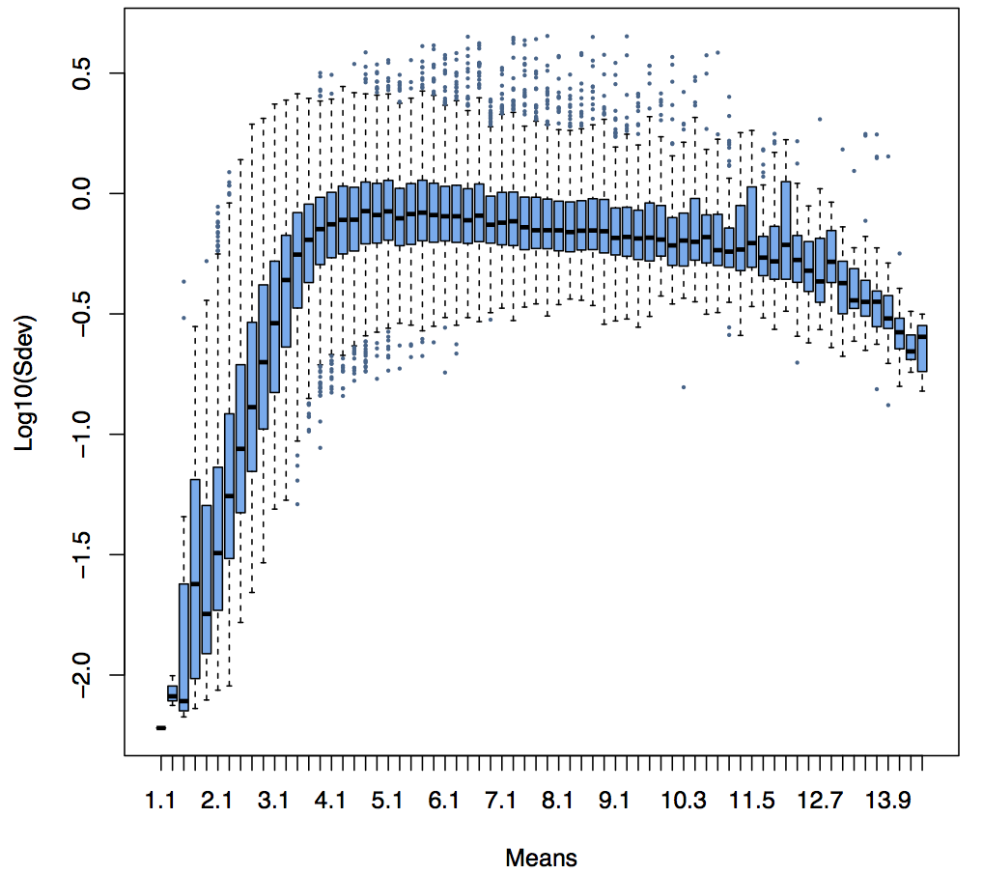
Adding some non informative probes
Eset
5000 ‘white’ probes
‘white’ probes

Slide 12
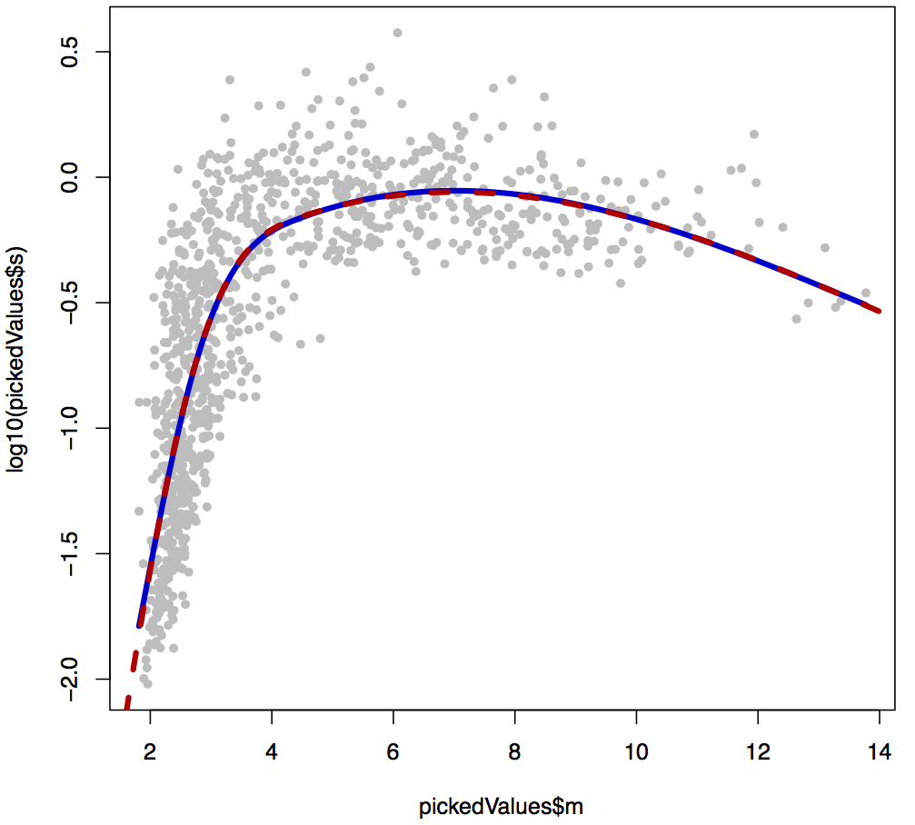
Standard deviations Vs. means (‘white’ probes)

Slide 13
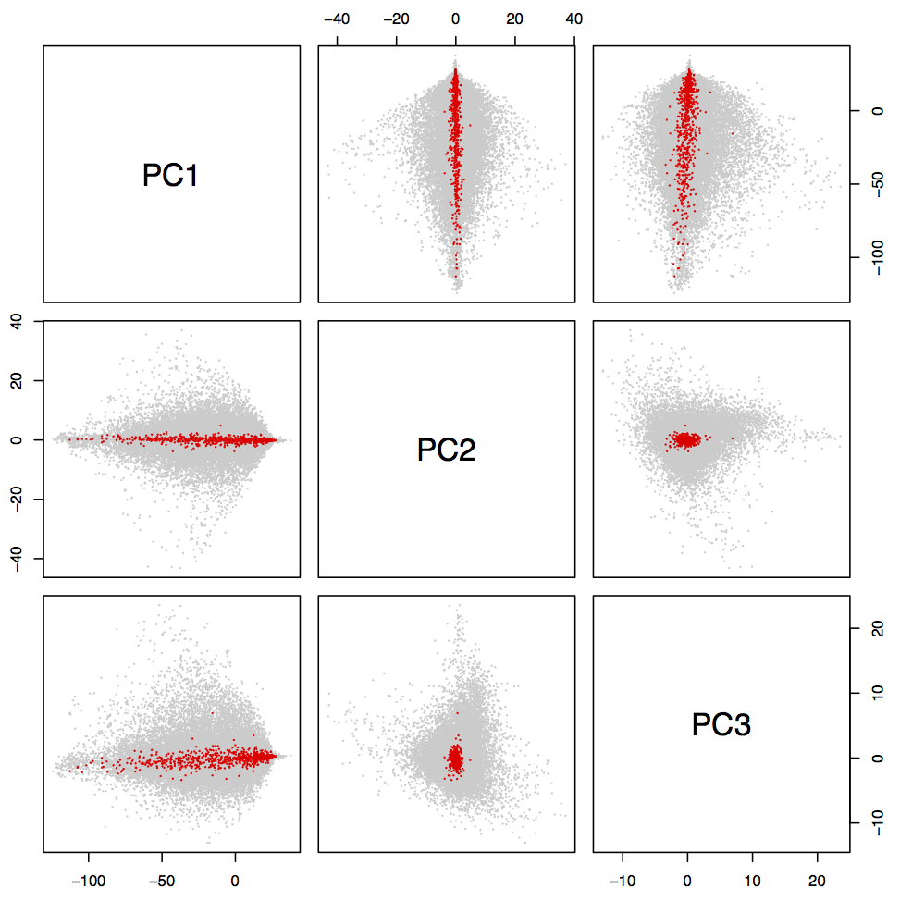
‘White’ probes location
Samples
Eset
Probes
‘white’ probes
‘White’ probes

Slide 14
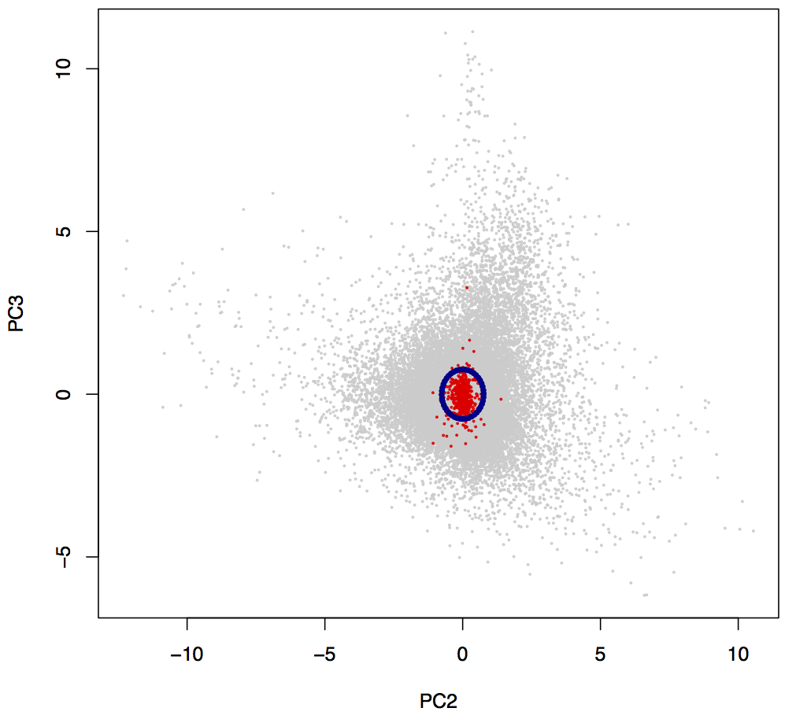
‘White’ probes threshold
‘White’ probes
q95 dist²

Slide 15
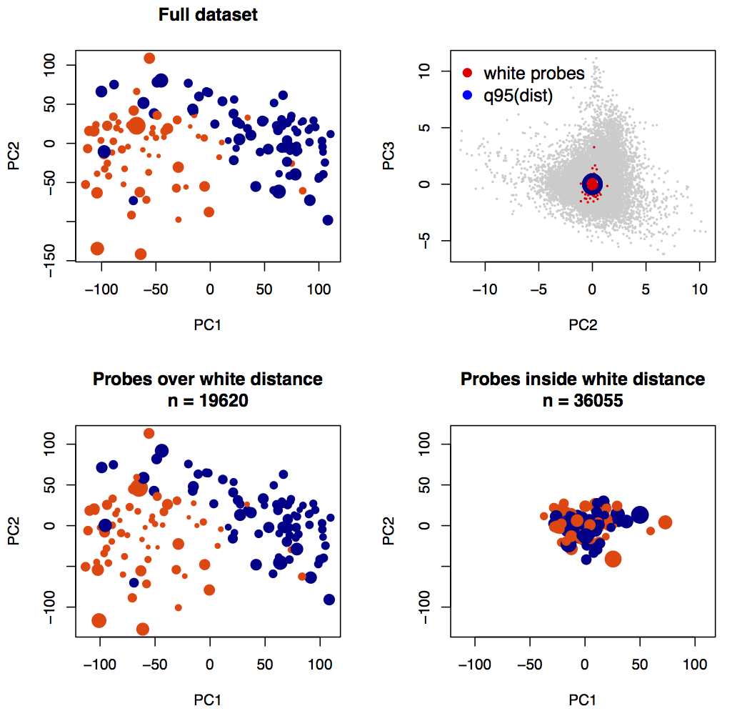
Informative probes selection

Slide 16
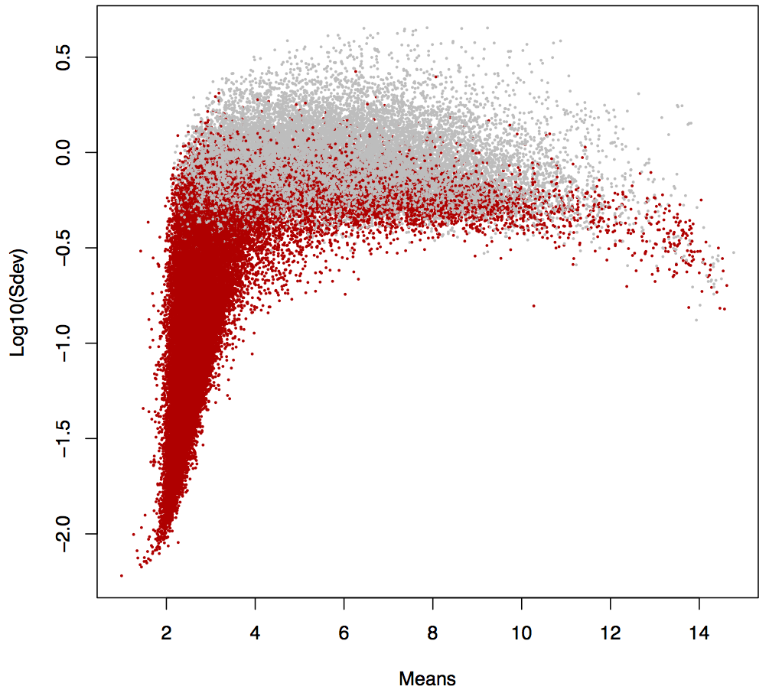
Non informative Sdev

Slide 17
Can we do better?

Slide 18
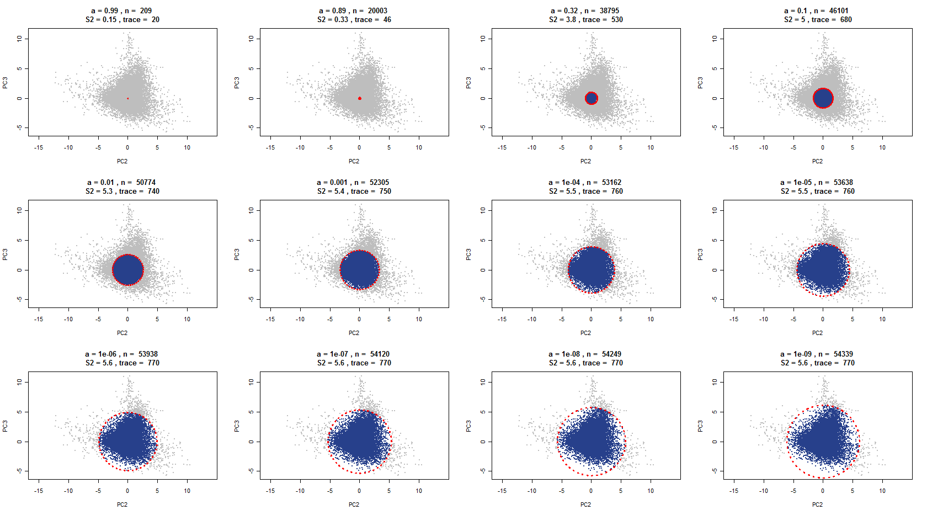
Increasing the radius…

Slide 19
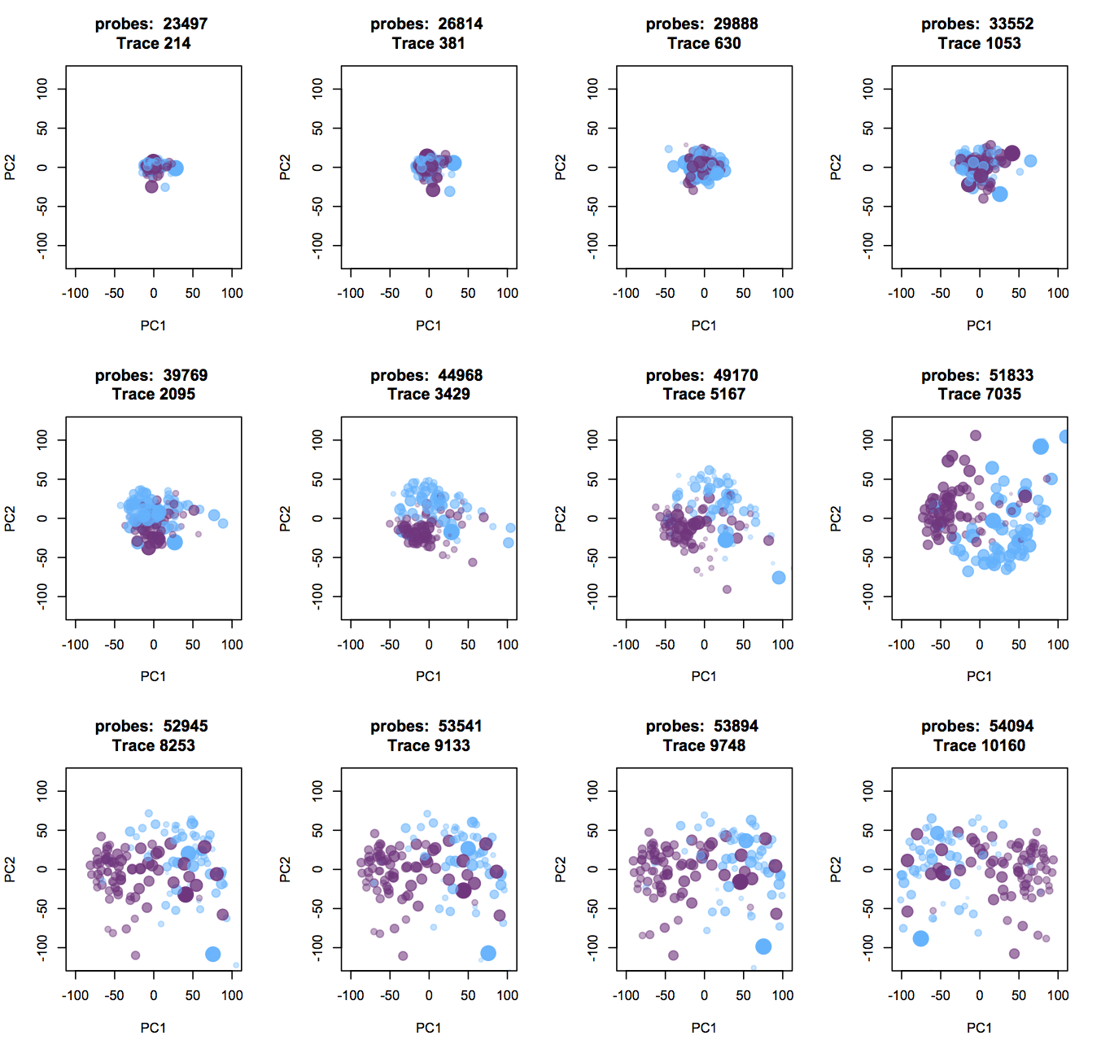
… increase the samples’ spread

Slide 20
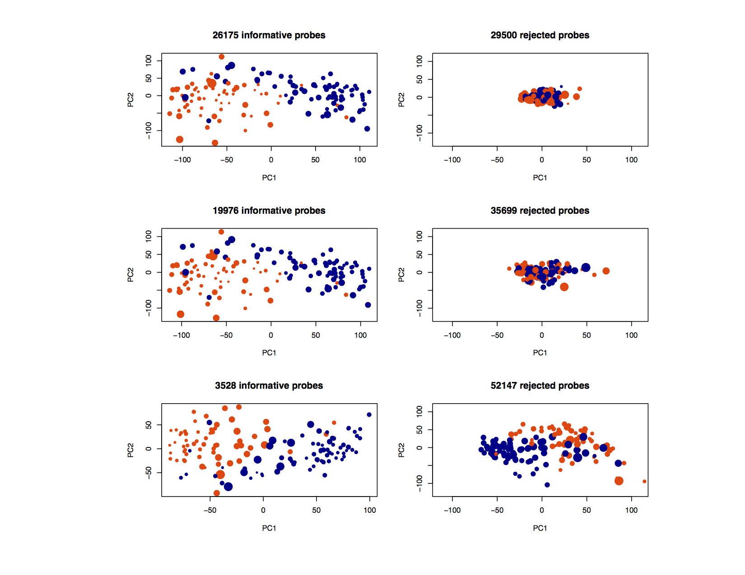
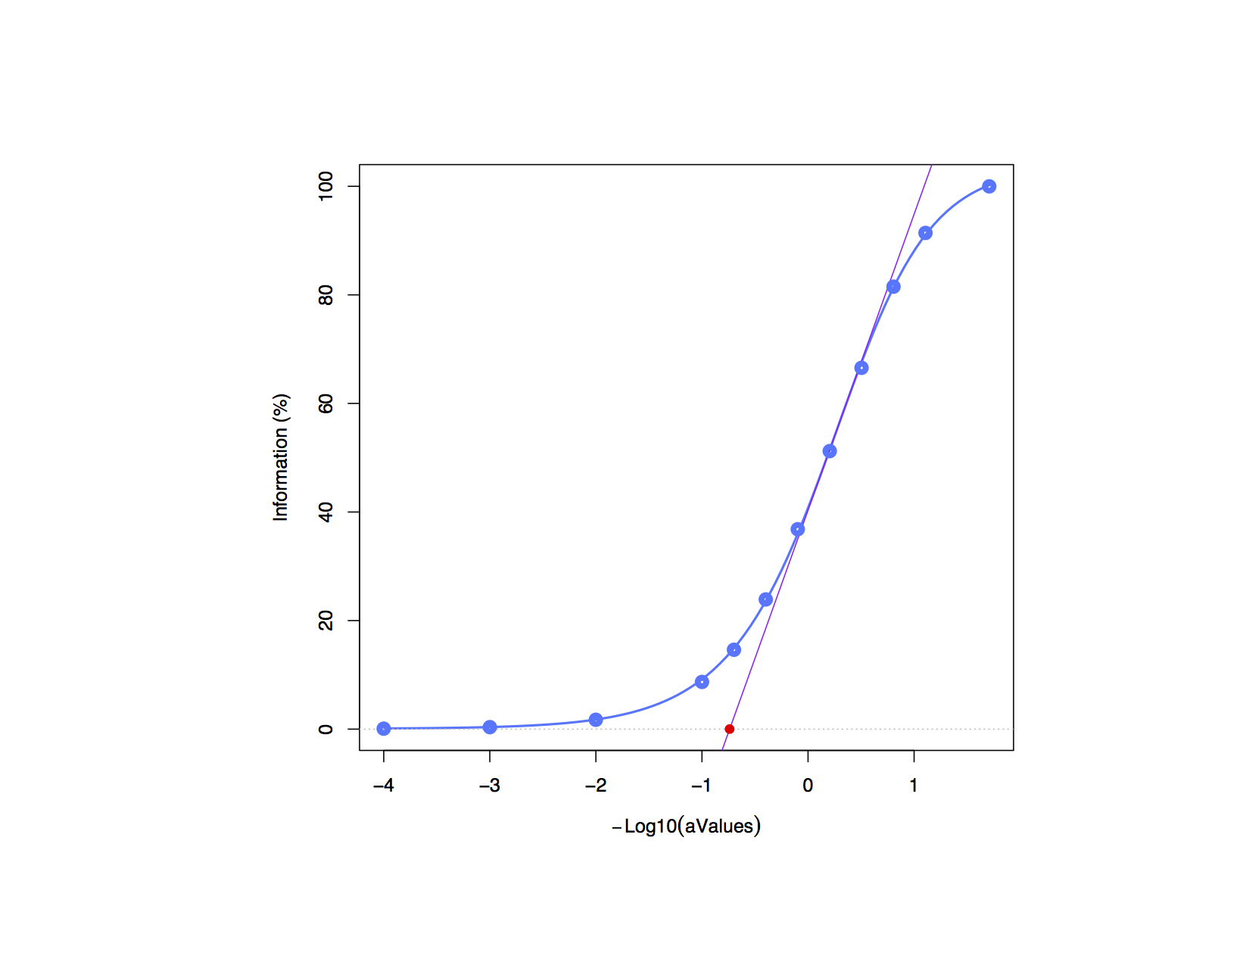
Using information curve
Lee data set
Trace of cov matrix according to threshold

Slide 21
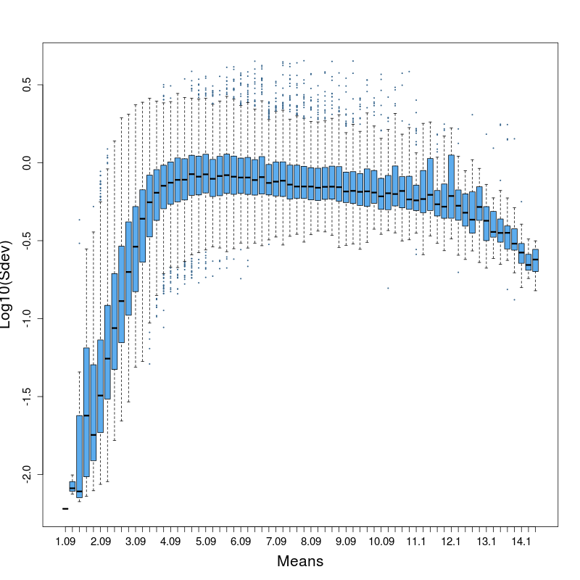
Log₁₀(Sdev) Vs. Means
Lee data set

Slide 22
Adding simulated probes
Original data set
Probes simulation
2500 ‘white’ probes
‘white’ probes
~500 ‘significant’ probes

Slide 23
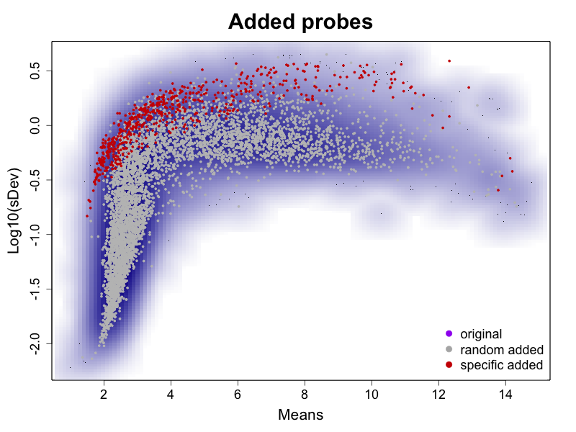
Simulated probes: Log₁₀(Sdev) Vs. Means

Slide 24
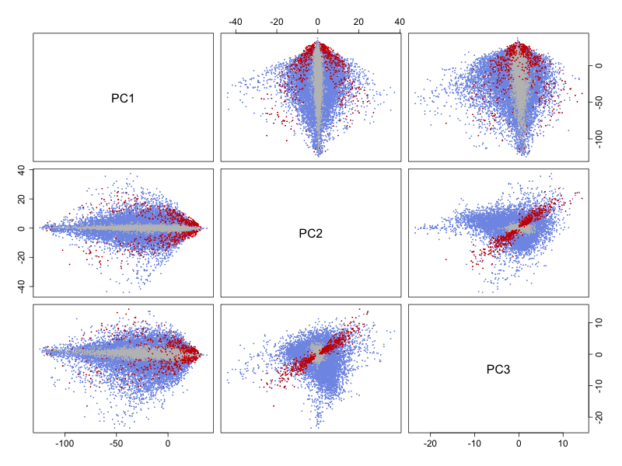
Simulated probes on PC axes

Slide 25
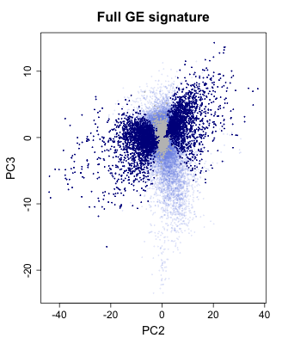
Differentially expressed probes on PC axes
Multiple testing procedure
Adenocarcinomas Vs. Squamous
mt.maxT: Sq Vs. Adk, adjp<1e-3
Signature | 3517 of 60743 (5.79%)
Random added | 0 of 5467 (0%)
Significant added | 563 of 601 (93.68%)

Slide 26
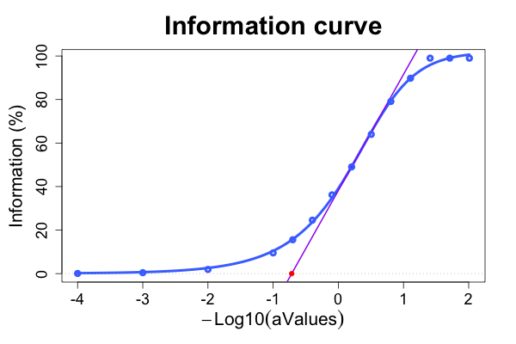
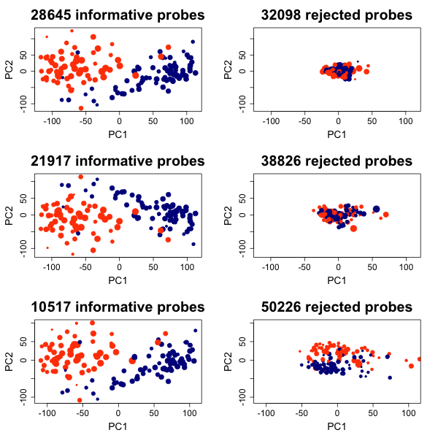
PCA-based filtering
5%
10%
25%

Slide 27
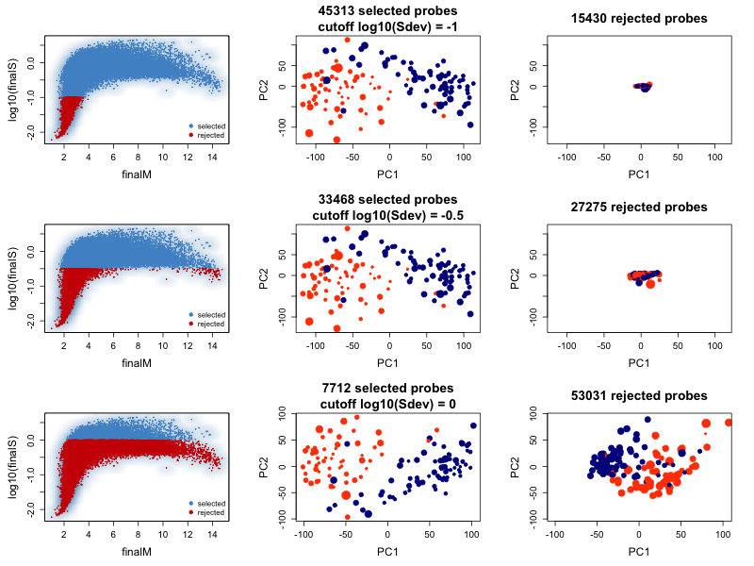
Variance-based filtering

Slide 28
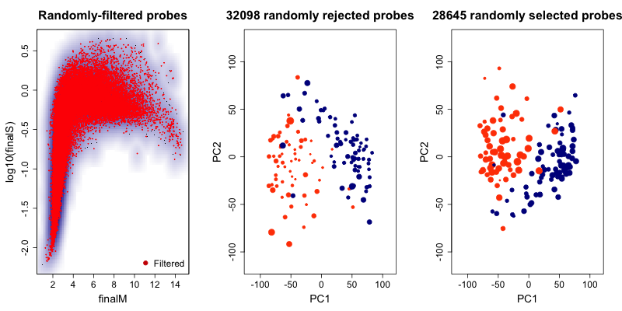
Random selection
Same number of probes as PCA filtering at 5%

Slide 29
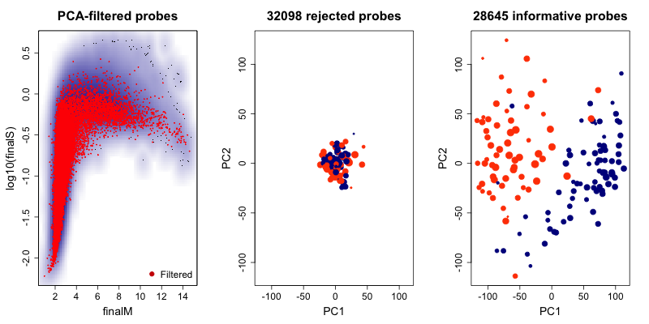
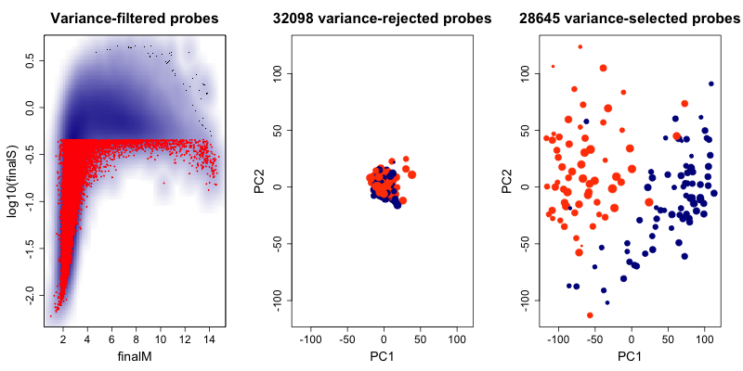
Filtering methods: effect on signature
PCA-filtering at 5%
Variance-filtering:
Cut off such that the same number of probes are selected, q53, s² > 0.45

Slide 30
Mt.maxT results
Sq Vs. Adk, adj.p < 1e-3

Slide 31
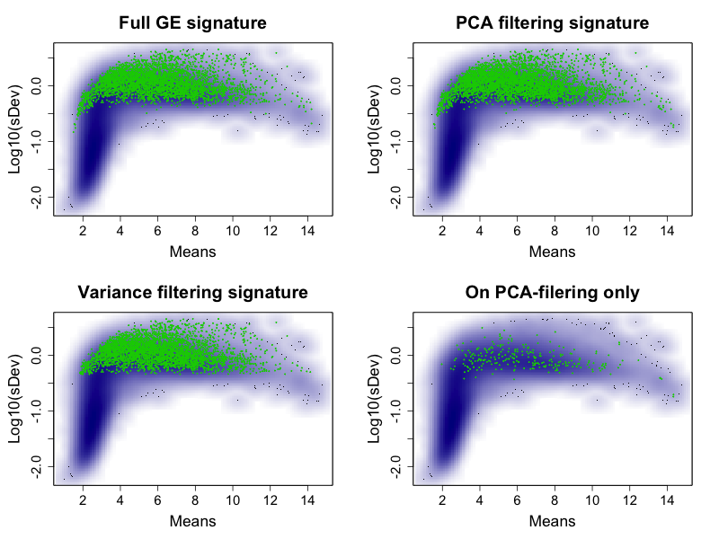
MS plot probes location

Slide 32
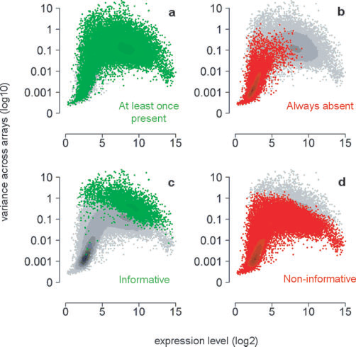
Talloen et al., Bioinfomatics 2007

Slide 33
Mt.maxT results table
mt.maxT Sq Vs. Adk, adjp<1e-3
 | Full data set | PCA filtered | Var filtered
Signature | 3517 | 3771 | 3444
Random added | 0 of 5467 (0%) | 0 of 5467 (0%) | 0 of 5467 (0%)
Significant added | 563 of 601 (93.68%) | 566 of 601 (94.49%) | 510 of 601 (93.24%)

Slide 34
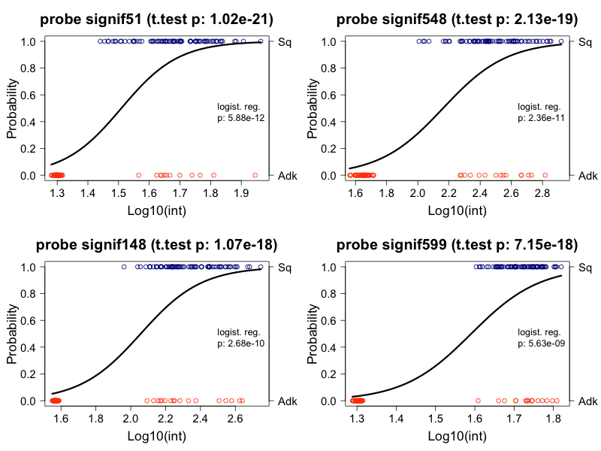
Added probes not in Variance filtering

Slide 35
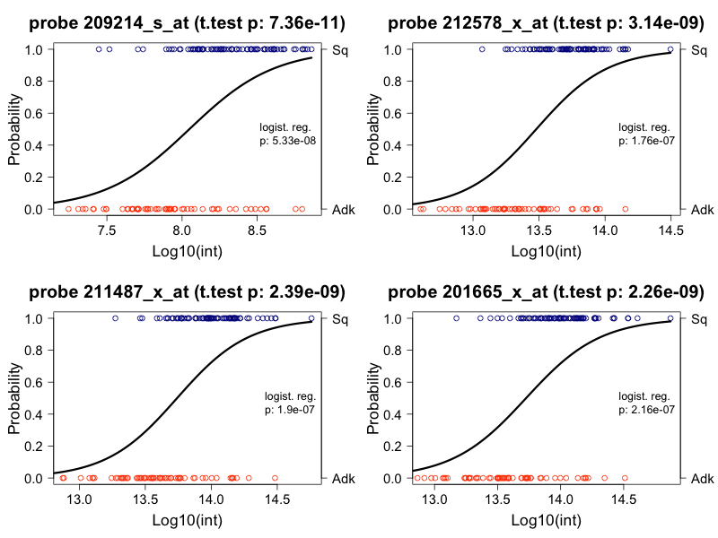
Real probes not in Variance filtering

Slide 36
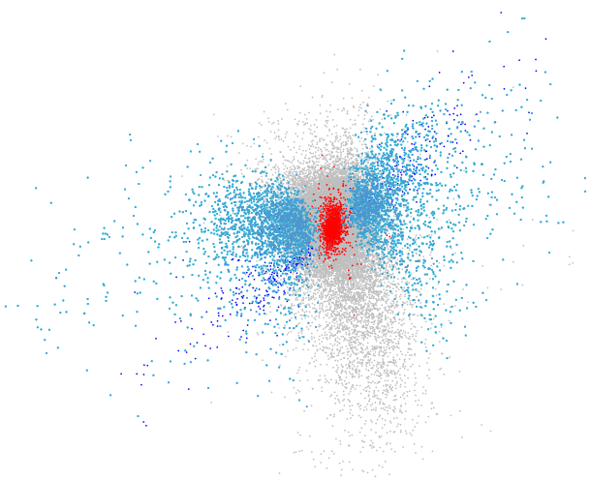
?
Non informatives
PC3
Discriminate
Adk Vs. Sq
???
PC2

Slide 37
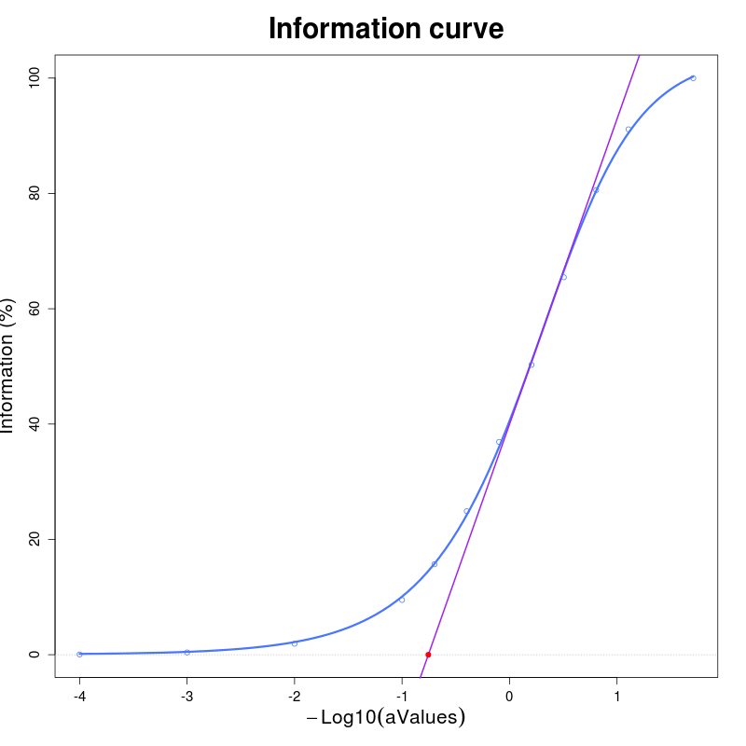
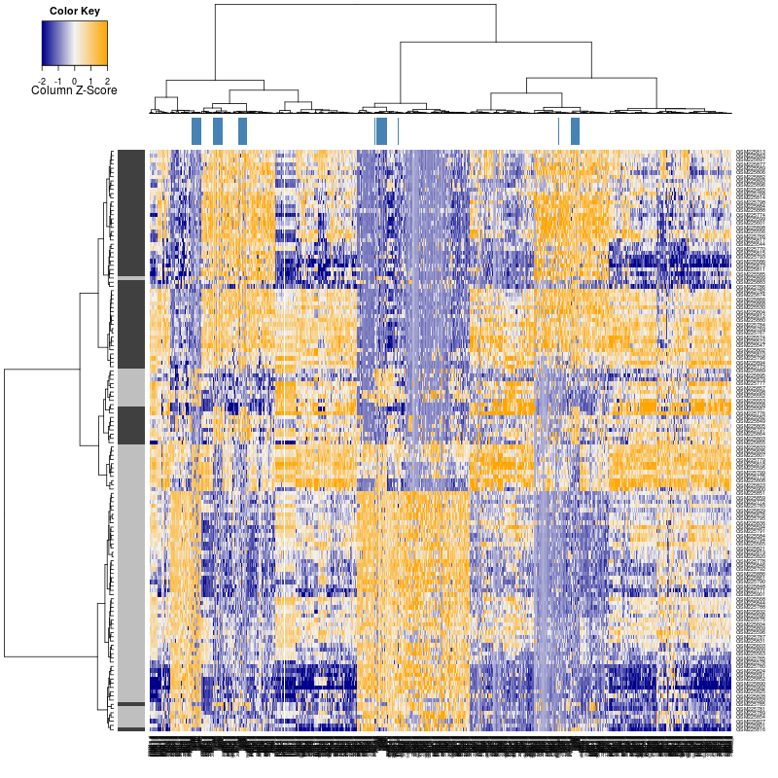
More stringent selection
Generated probes
Information curve
Cut at 70%
56507 rejected probes (~ 98%)
Adk
Sqk

Slide 38
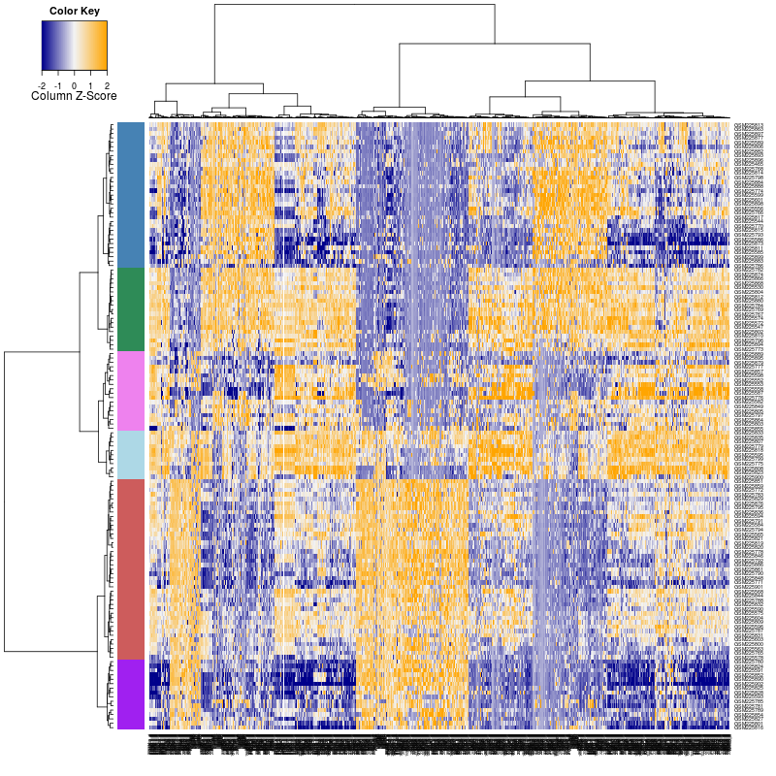
Trying clusters
Samples are clustered into 6 groups, then the probes are tested for these groups.
1160 of the 1168 probes are significant,
adj.p-value ≤ 0.01

Slide 39
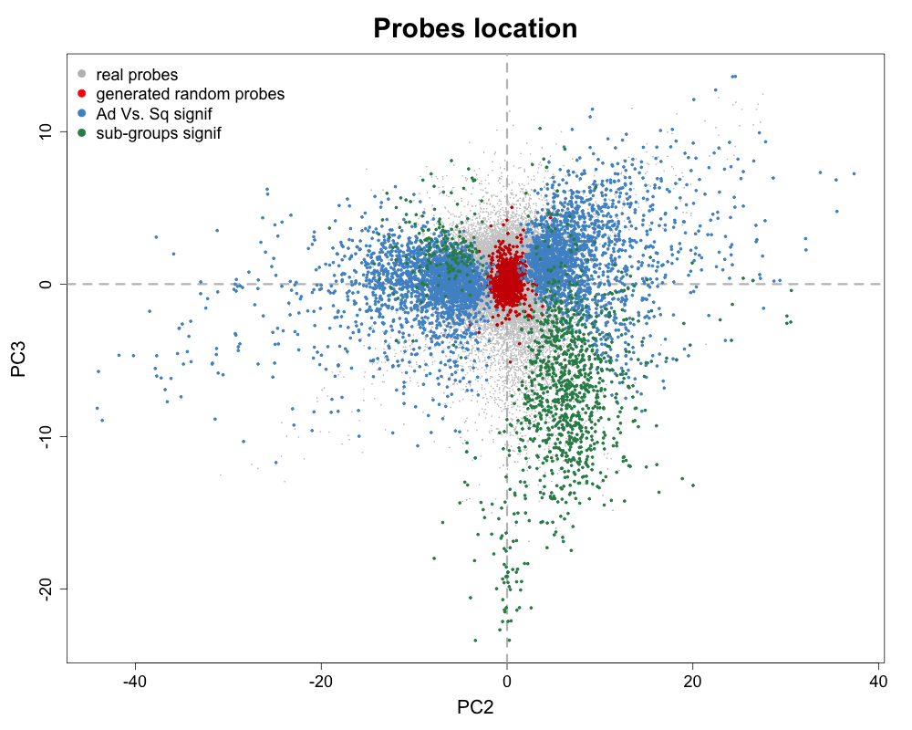
A sub-groups signature?
Non informatives
Dsicriminate
Adk Vs. Sq
Sub-groups

Slide 40
A possible probes space model
PC2 : groups (λ2)
PC3 : sub-groups (λ3)
PC1 : population (λ1)

Slide 41
Some other examples

Slide 42
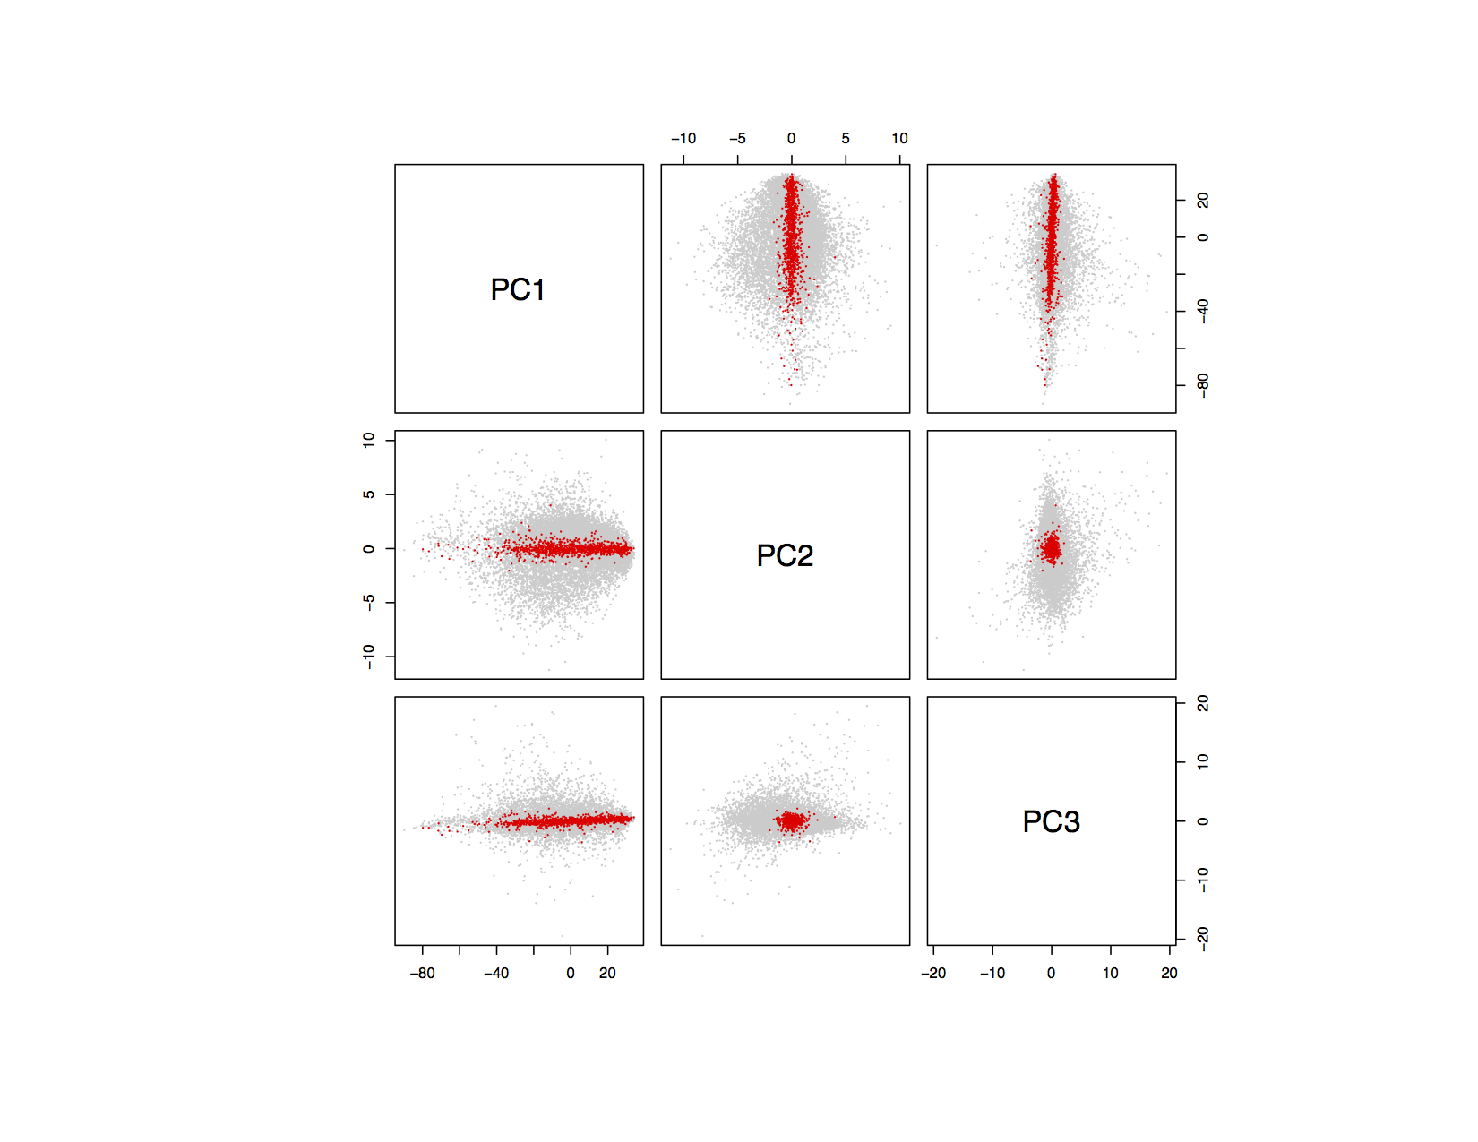
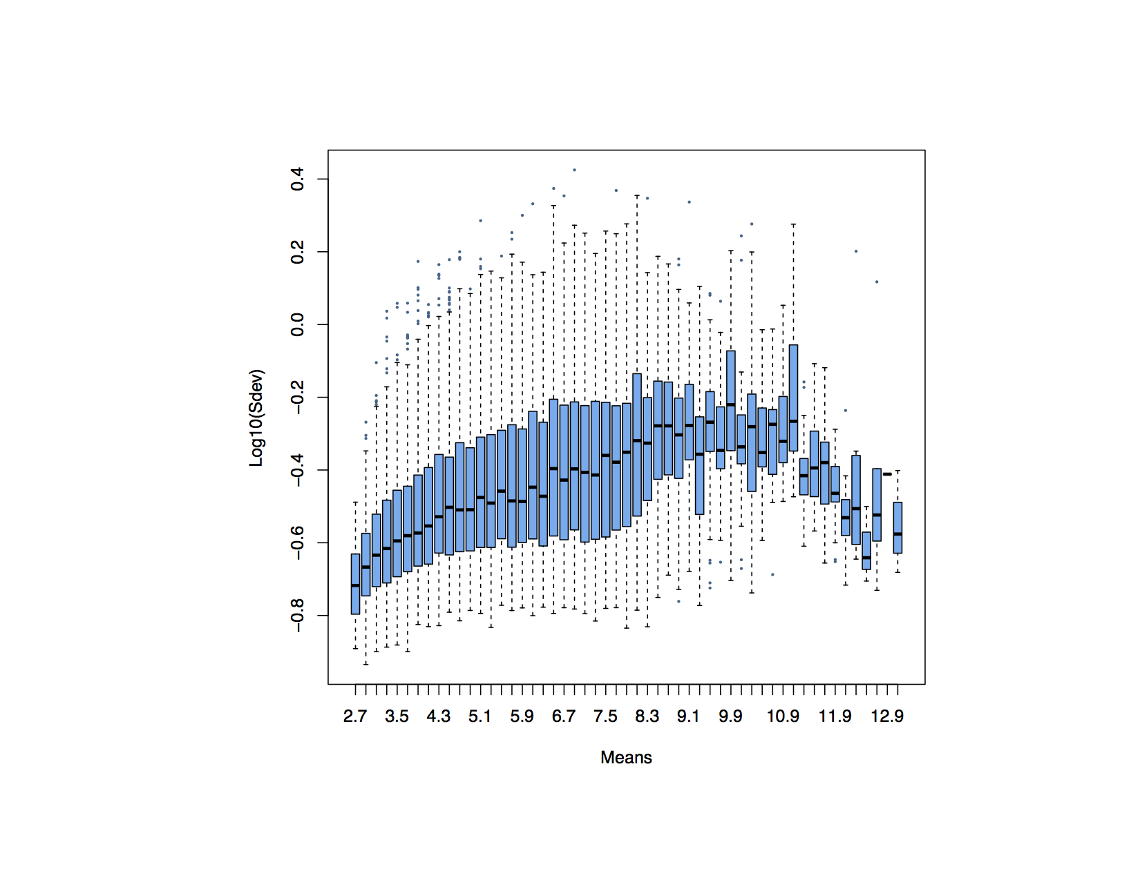
Leucemia B Vs. T, Chiaretti et al., 2004

Slide 43
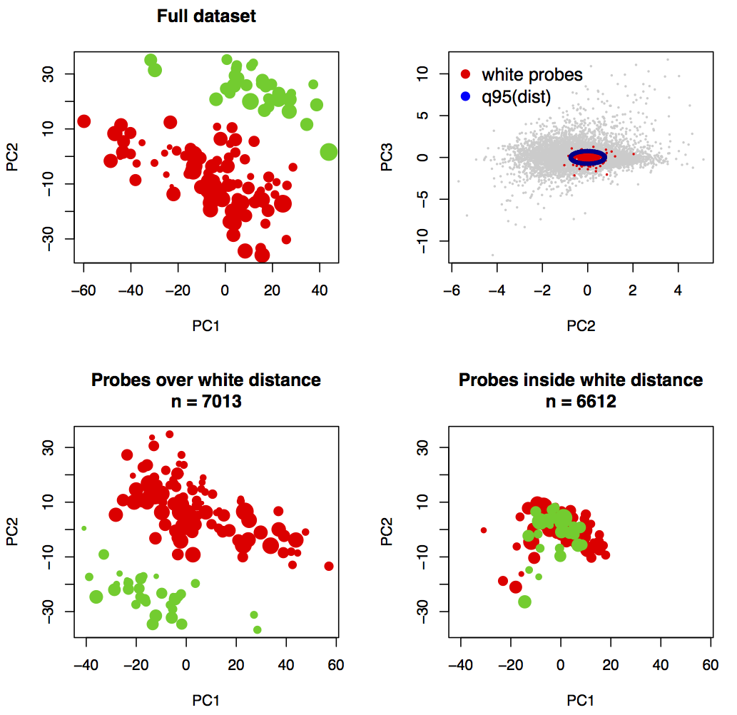
Leucemia B Vs. T, Chiaretti et al., 2004

Slide 44
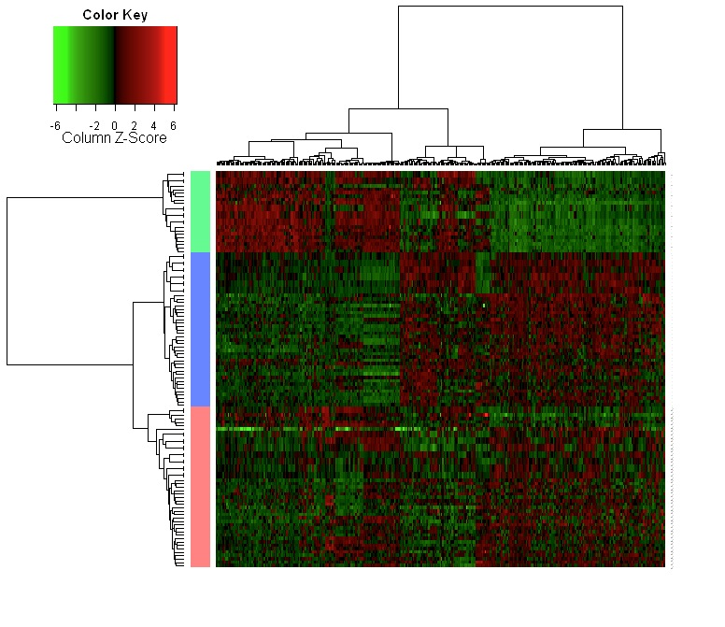
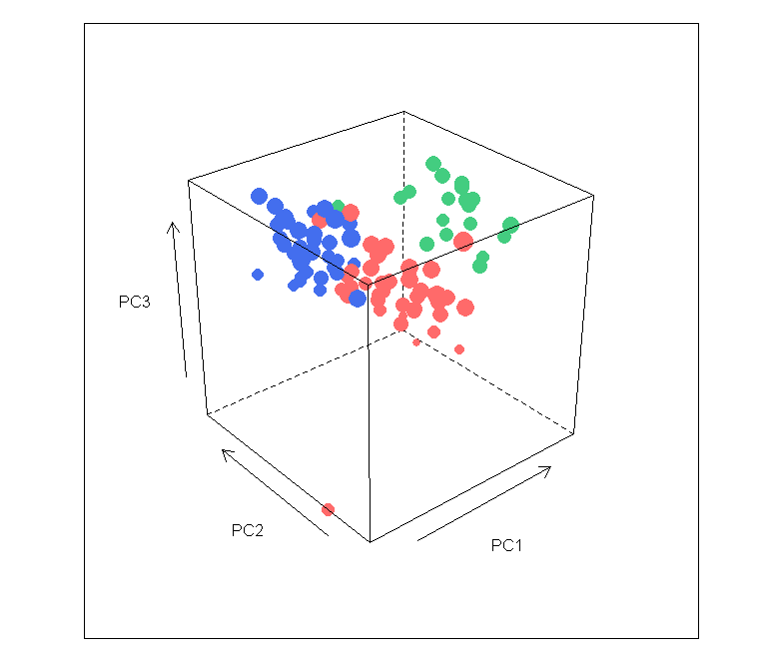
Van’t Veer, breast metastasis

Slide 45
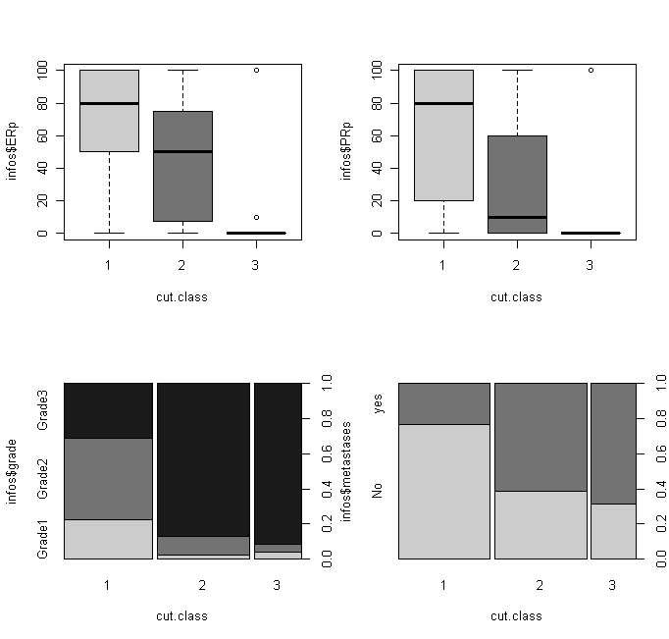
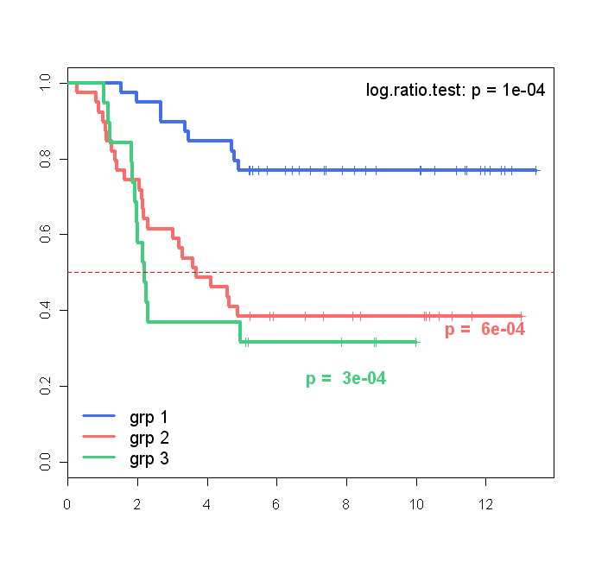
Van’t Veer, breast metastasis
ER
PR
Metastasis (5years)
Grade
Metastasis
years

Slide 46
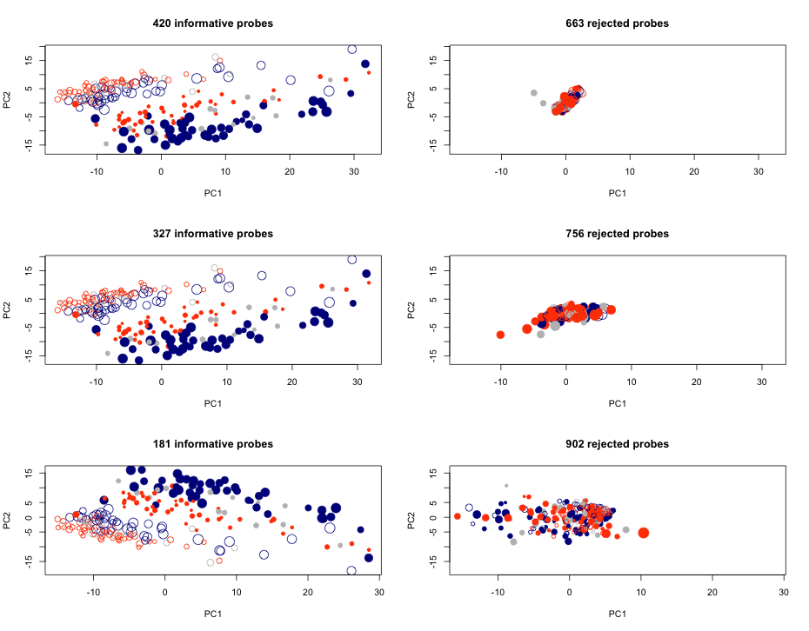
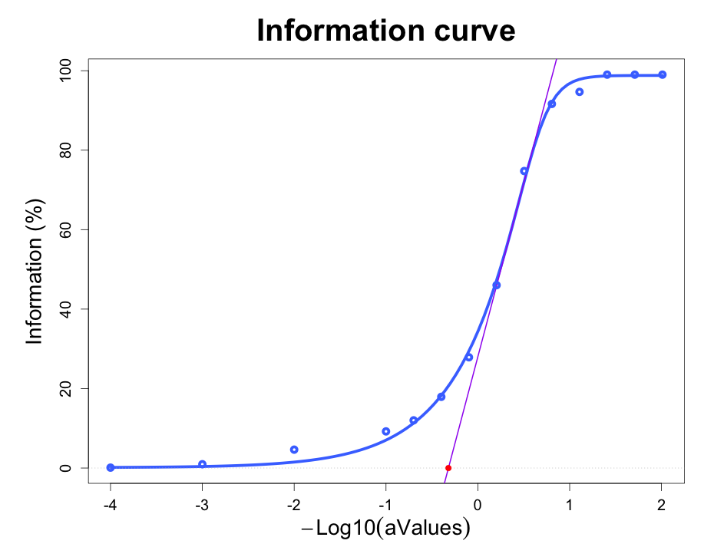
Chemores miRNA, Adk + Sq + paired normal
5%
10%
25%

Slide 47
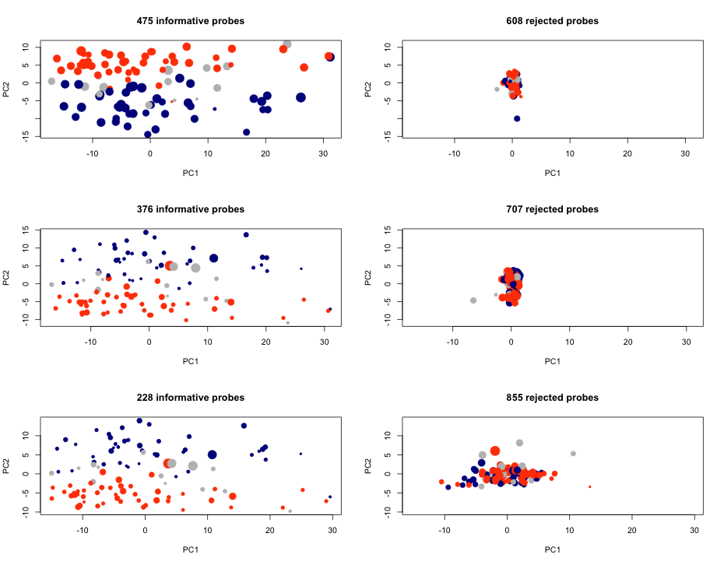
Chemores miRNA, on tumors only
5%
(663)
10%
(756)
25%
(902)

Slide 48
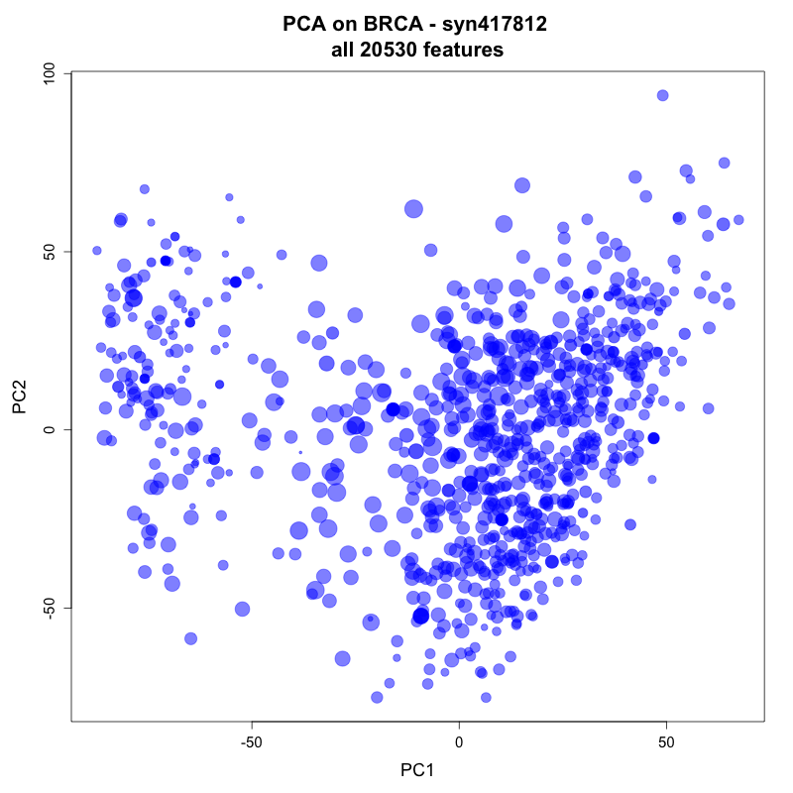
TCGA – BRCA RNAseq

Slide 49
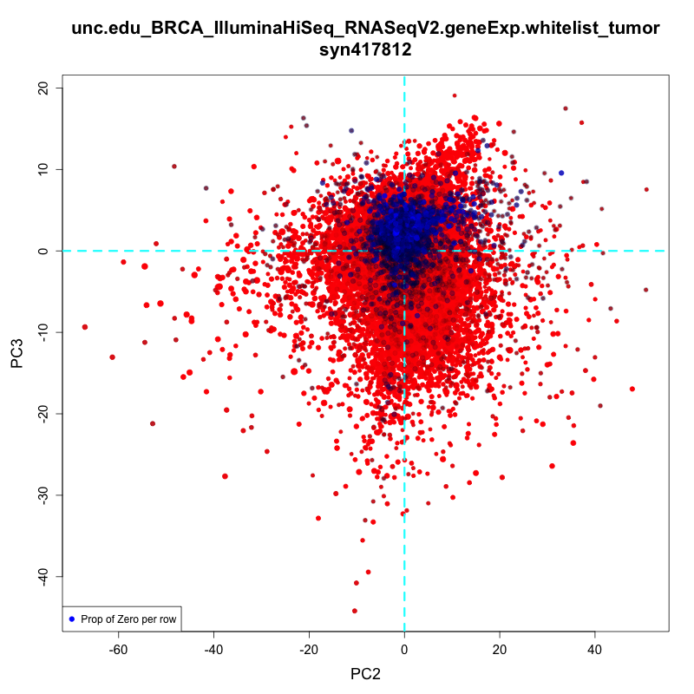
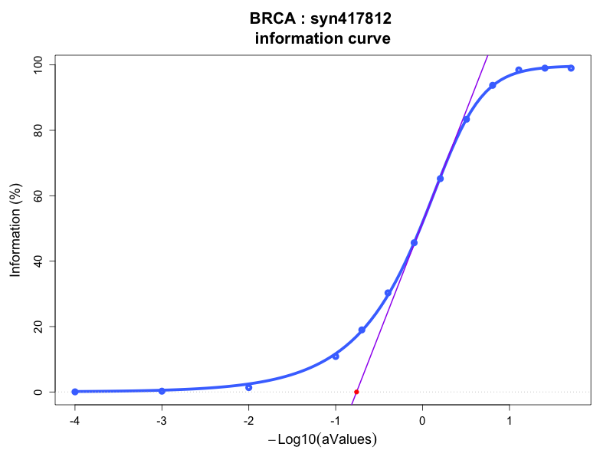
TCGA – BRCA RNAseq

Slide 50
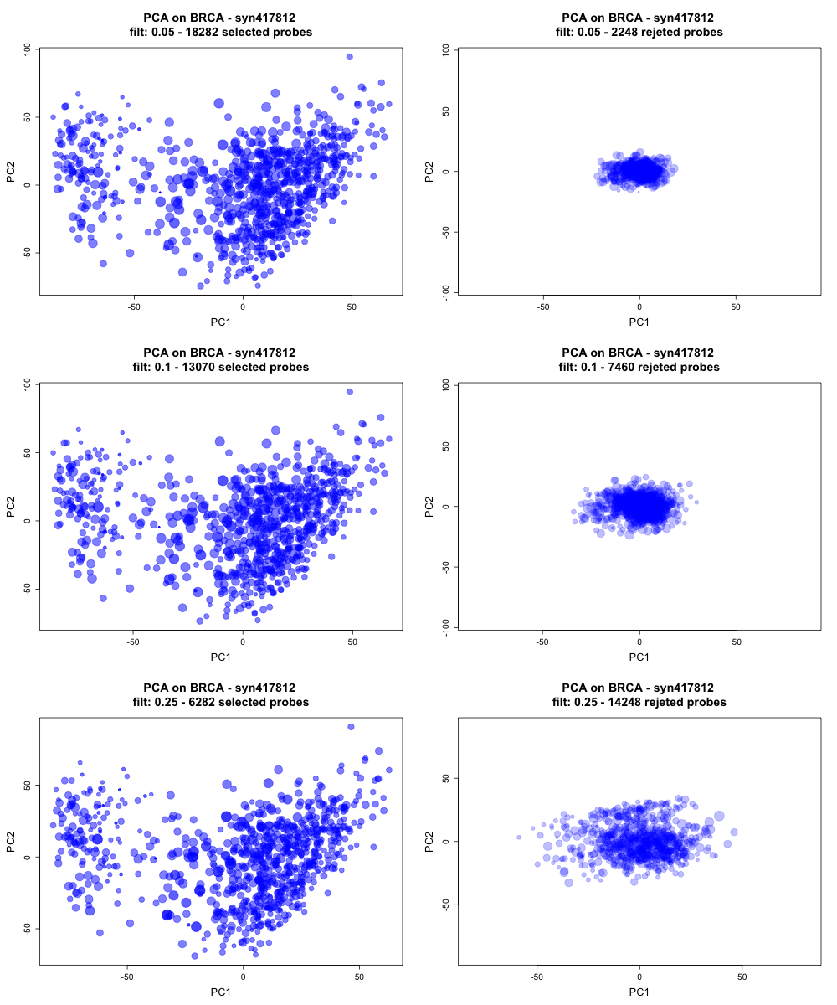
TCGA – BRCA RNAseq

Slide 51
Using the information curve
to find the best correlated probes.
TCGA – GBM, LUSC, OV
RNASeq Vs. HGU-133

Slide 52
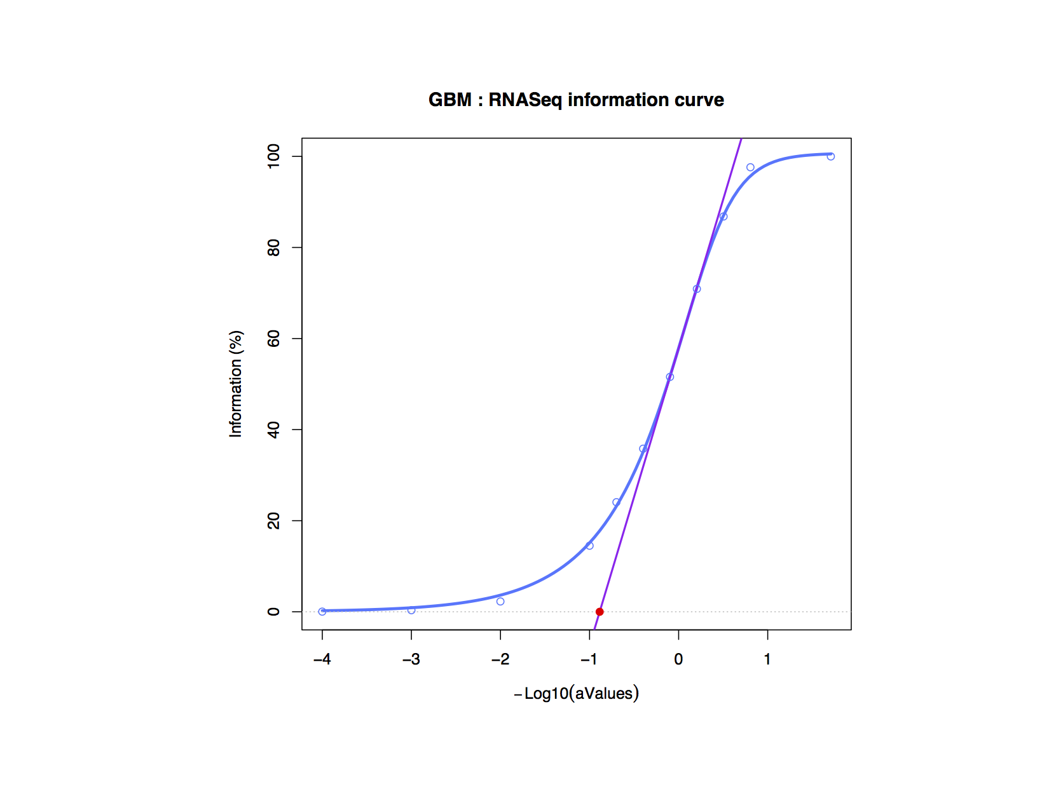
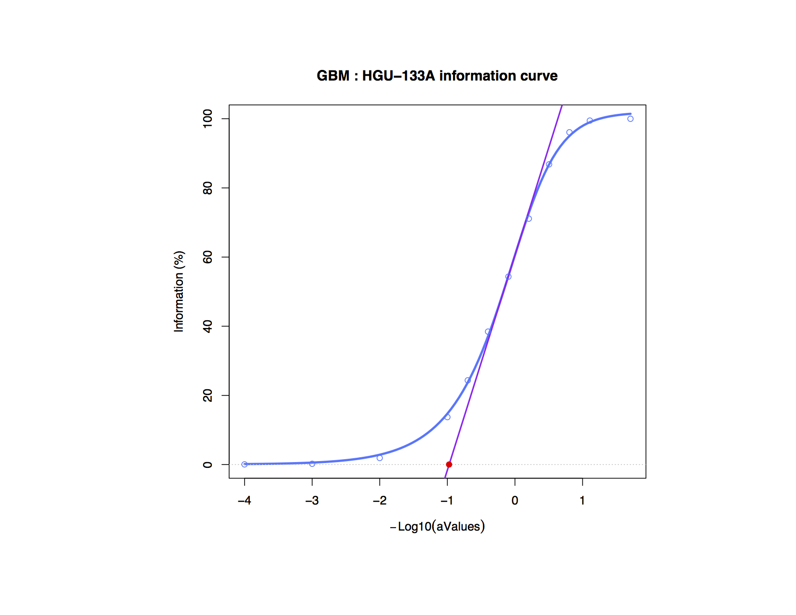
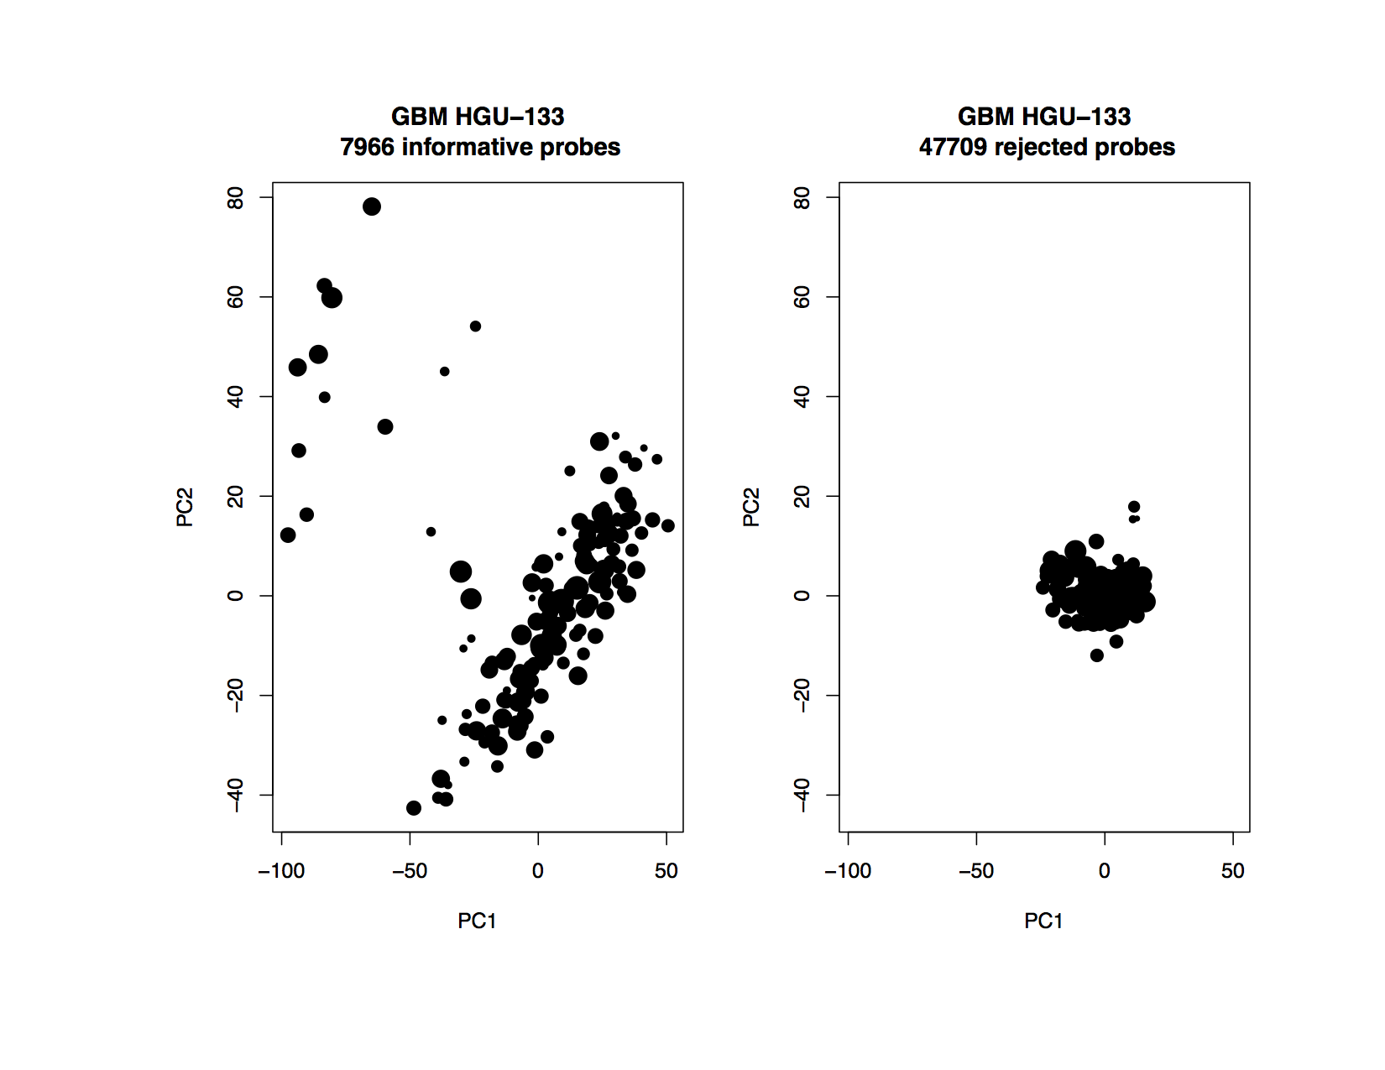


Slide 53


Slide 54


Slide 55


Slide 56


Slide 57





Slide 58





Slide 59
Conclusion
The PCA-based filtering method
- Intuitive and easy to implement.
- Less loss of information than a variance-based filtering method
- Provides a filtering metric to get the informative probes

